Slide 1



SPCS Contracting Services

Slide 2


Intake
Negotiation
Signature
Executed
Introductions
The Contracting Process
Metrics
Tracking Your Contract

Slide 3

Organization
SPCS
Preaward/ Contracting
Postaward
Proposals
Team 1
Contracting
Team 2
Team 3
Awards
Team 4
Subawards
(Outgoing)
Compliance,
Audit, Property,
Subrecipient Monitoring

Slide 4
Meet Contracting Services
Steve Harsy
Director
Savannah Corral
Contracts Coordinator

Slide 5
Meet Contracting Services
Mark A. Drury
Manager, Government & Non Profit
Radha Radhakrishnan
Manager, Industry Contracts

Slide 6
Government & Non-Profit
Melissa Kramer
Chuck Smart

Slide 7
Government & Non-Profit
Izetta Morris
Chris Barnhill

Slide 8
Industry
John Annibal
Peter Stamm

Slide 9
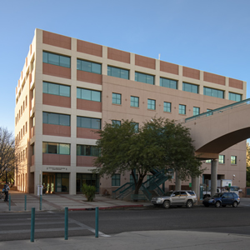
Mission
Contracting Services efficiently executes contracts to get UA researchers the outside resources they need to be successful
Structure agreements to create the optimum agreement for the desired relationship
Negotiate contract terms with sponsor that give researchers the rights needed to conduct projects, while minimizing risks and burdensome obligations
Engage with offices across campus to manage terms in special circumstances
Sign contracts and agreements as the authorized institutional signatory

Slide 10
Intake
Negotiation
Signature
Executed
Introductions
The Contracting Process
Metrics
Tracking Your Contract

Slide 11
Where Do I Send My Contract?
SPCS Contracting Services
  Incoming funds, unfunded agreements, for non-UAHS PIs
UAHS Contracting Office
  Incoming funds, unfunded agreements for UAHS PIs
Procurement and Contracting Services (PACS)
  Purchases of supplies, equipment, and services by UA
Tech Launch Arizona (TLA)
  Outgoing MTAs; CDAs relating to licensing discussions
Notes:
Analytics

Slide 12
Where Do I Send My Contract?
Grants Contracts
Material Transfer Agreements Data Use Agreements
Confidentiality/Non-Disclosure Agreements
Testing/Professional Services Memoranda of Understanding Intergovernmental Agreements
Teaming Agreements Student Experience Agreements
Museum of Art/Center for Creative Photography Agreements
Notes:
Analytics

Slide 13
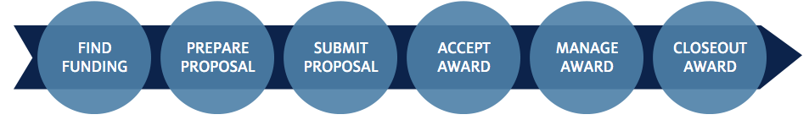
The Contracting Process
Intake
Negotiation
Signature
Executed

Slide 14

The Contracting Process
Intake
Negotiation
Signature
Executed
Notes:
Analytics

Slide 15
The Contracting Process
Intake
Negotiation
Signature
Executed
What do we need to give you the best and quickest service?
Contract Submission Cover Sheet
Export Control Checklist (if an export-control related area)
Contract in Word format (unless Contracting is asked to provide our template to sponsor)
Workscope
Budget (estimate is fine)
Appropriate lead time
Notes:
Analytics

Slide 16
The Contracting Process
Intake
Insert Contract Submission Cover Sheet
Notes:
Analytics

Slide 17
The Contracting Process
Needed for space sciences, chemistry, physics, materials science, geosciences, engineering, electronics, computer science, management information systems, instrumentation design and use, and related fields
Intake
Insert Contract Submission Cover Sheet
Notes:
Analytics

Slide 18
The Contracting Process
Intake
Negotiation
Signature
Executed
SPCS in-box
PI
Sponsor
Contract Submission Cover Sheet
to PI/ Department
Acknowledgement of Receipt and Assignment
Contracts Coordinator
to Manager
Negotiator Assignment
Export Control Checklist
PI Acknowledgement of Terms (Amendments)
Notes:
Analytics

Slide 19
The Contracting Process
Intake
Negotiation
Signature
Executed
Documents are logged into the UAccess Negotiations Log
Assigned a unique Negotiation Log # (this is your tracking #)
Forwarded to Mark (Government & Non-Profit) or to Radha (Industry) for assignment
Assigned to a Negotiator
This Information is emailed to the Department contact and assigned PI
Notes:
Analytics

Slide 20
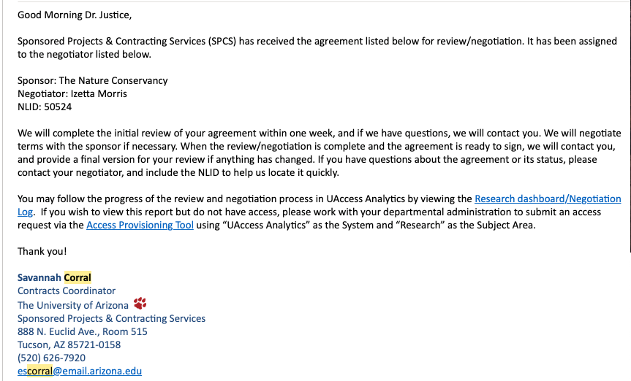
The Contracting Process
Intake
Notes:
Analytics

Slide 21

The Contracting Process
Intake
Negotiation
Signature
Executed
The assigned negotiator works with the sponsor and others to develop an acceptable contract
Notes:
Analytics

Slide 22
The Contracting Process
Intake
Negotiation
Signature
Executed
Department
OGC
PI
Contract Negotiator
COI
Sponsor
Risk Management
TLA
Postaward
Notes:
Analytics

Slide 23
The Contracting Process
Intake
Negotiation
Signature
Executed
Guidelines for Negotiation Turnaround
First review on CDAs – 3 days
First review on all other agreements – 1 week
Follow-ups on outstanding agreements – 1 week
Notes:
Analytics

Slide 24
The Contracting Process
Intake
Negotiation
Signature
Executed
Negotiator prepares package for signature, gets PI signature if necessary, then submits to UA authorized signatory
Agreement signed, given to Contracts Coordinator
Notes:
Analytics

Slide 25
The Contracting Process
Intake
Negotiation
Signature
Executed
Contracts Coordinator manages the rest of the process
  pdf exchange of documents by email (preferred)
  E-signature process (AdobeSign, DocuSign, sponsor system)
  Wet-ink signatures
Weekly follow-up for outstanding signatures
Notes:
Analytics

Slide 26
The Contracting Process
Intake
Negotiation
Signature
Executed
Contracts Coordinator distributes scanned copies of the fully executed agreement to sponsor, PI, department admin, other requested parties
Copy uploaded to Docuware
Notes:
Analytics

Slide 27
The Contracting Process
Intake
Negotiation
Signature
Executed
The signed contract is transferred to the next unit, depending upon contract type:
  Sponsored activities >> Award Services for account setup
  Service/recharge center agreements >> FSO
  Unfunded agreements >> keep in Contracting Services
  Proposal documents >> Proposal Services
  Subawards >> Subaward Services
Notes:
Analytics

Slide 28
Intake
Negotiation
Signature
Executed
Introductions
The Contracting Process
Metrics
Tracking Your Contract

Slide 29
How Long Does it Take?
Median time to execution: 26 days
57% of agreements are executed within
1 month of receipt
81% of agreements are executed within
2 months of receipt
Contracts received 5/1/2018 to
4/30/2019 and not withdrawn

Slide 30
How Many Agreements Do We Do?
About 2400 agreements per year
= 47 new agreements every week
~69% of agreements are sponsored agreements
~31% of agreements are non-sponsored

Slide 31
Intake
Negotiation
Signature
Executed
Introductions
The Contracting Process
Metrics
Tracking Your Contract

Slide 32
The Contracting Process
Intake
Notes:
Analytics

Slide 33
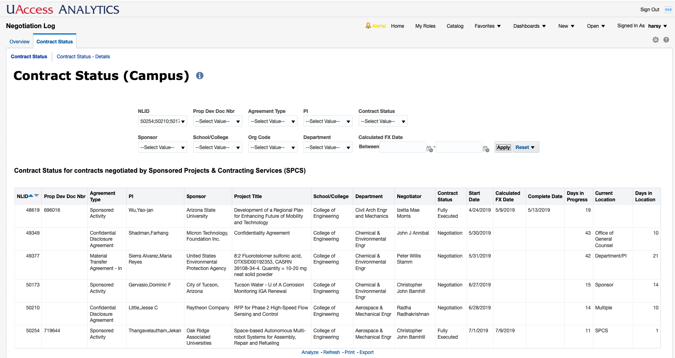

Slide 34
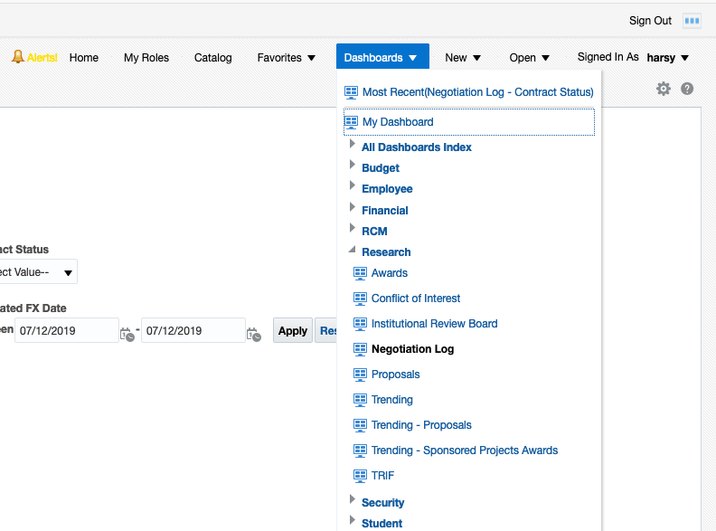

Slide 36
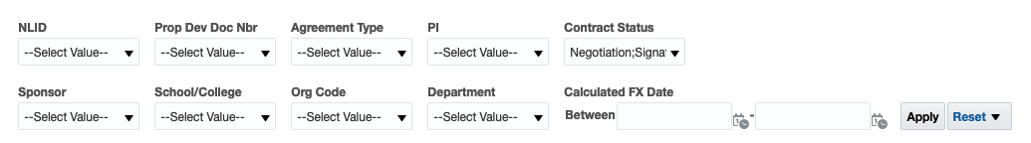

Slide 37
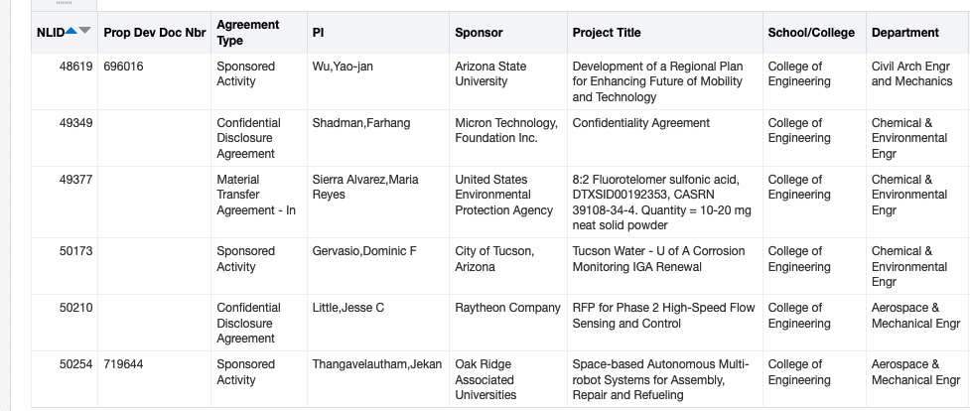

Slide 38
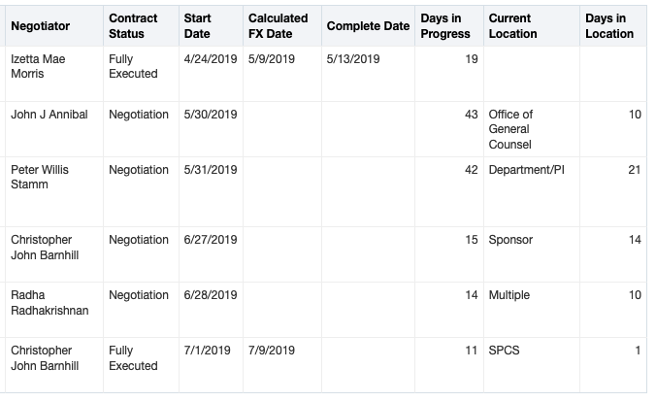

Slide 39
Status
Negotiation
Signature
Fully Executed

Slide 40
Date complete package received in Contracting

Slide 41
Date contract is fully executed

Slide 42
If sponsored, date account is set up; otherwise, same as FX date

Slide 43
If FX, days to FX; otherwise, days in progress

Slide 44
If in progress, whose desk it is on

Slide 45
If in progress, how long has it been at the current location

Slide 47
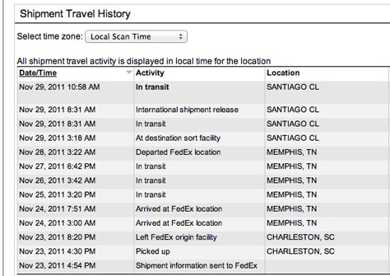
Tracking Your Contract
Notes:
Analytics

Slide 48
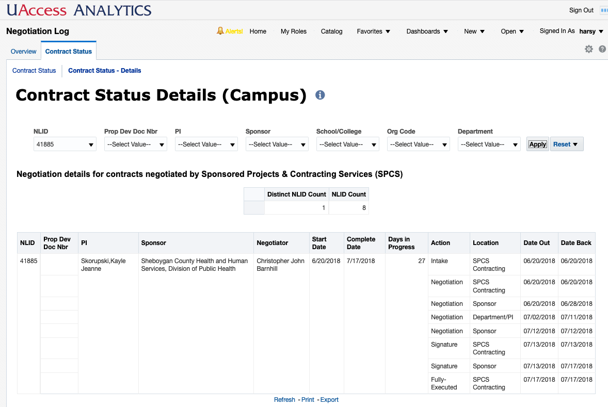

Slide 49
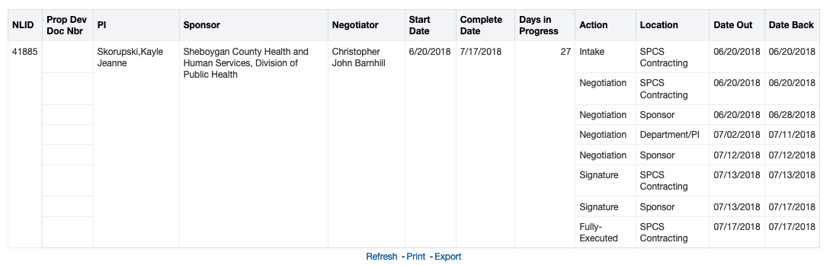

Slide 50
Contact Us
contracting@email.arizona.edu
520-626-7920
(Savannah Corral)
Notes:
Analytics

